Slide 1

CanberraUAV Workshop Communications links
Feb 2017

Slide 2
Communications
The ability to:
Receive timely telemetry
Reliably command the UAV
Includes RC controllers and GCS computers
For safety, a UAV must be able to be commanded at any time

Slide 3
Communications
There are many types of communications
Mavlink is independent of the communications hardware
Will skip over RC controllers
Simple, direct manual control of the UAV
Range limit of ~500m
Limit is more the pilot’s eyesight rather than the radio range

Slide 4
Communications
Link budget tells us the expected range from a given output power (and vice-versa)
EIRP = Effective Isotropic Radiated Power (power out of antenna)
FSL = free space loss
Radio output (Pout) + Antenna gain G(TX) = EIRP
Pout + G(TX) - FSL >= G(RX) + P(thres)
P(thres) is the radio sensitivity. Depends on modulation and datarate
Note all units in dB or dWB

Slide 5

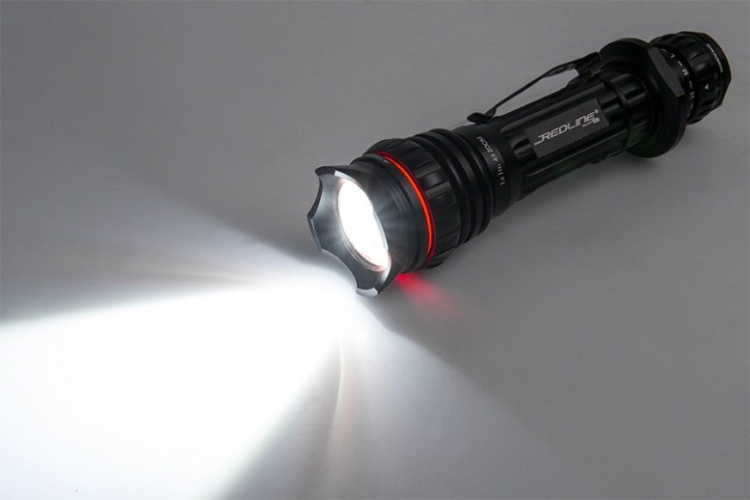
Communications
Antennas
Low gain, non-directional
High gain, directional

Slide 6
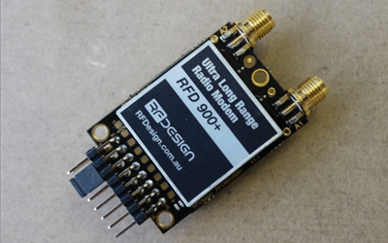
Comms - Point-to-point RF links
Simple serial->RF radios
Typically 57600 baud
Operate on the 915-928 Mhz band (in AUS)
20km+ range, limited by line of sight

Slide 7
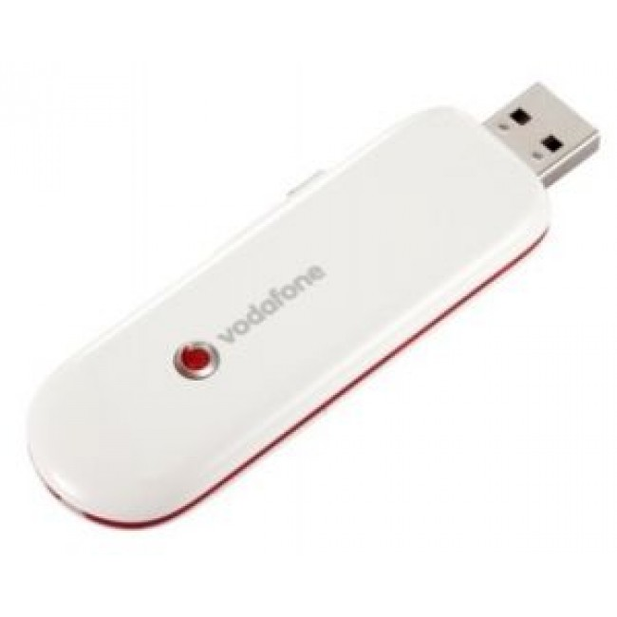
Comms - 3G/4G modems
High bandwidth
Unlimited range*
(as long as you’ve got network coverage)
Can be difficult setting up a network
No public IP’s ☹

Slide 8
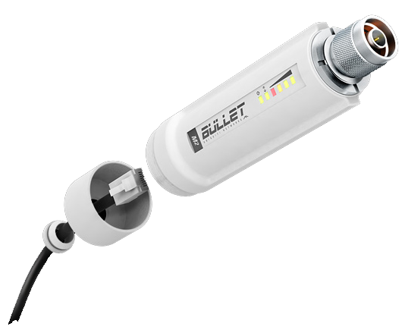
Comms - Long Range Wifi
High bandwidth
5km range with good antennas
Complete control of link

Slide 9
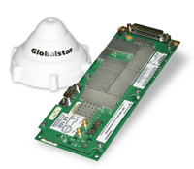
Comms - Satellite
Very, very expensive
Modem/Antenna size is an issue
10-20 kbps bandwidth
Coverage depends on provider

Slide 10
Comms - Bandwidth
How much bandwidth do you need?
MAVLink typically uses 2-4 kbps
Live imagery can use a few 100kbps, depending on resolution, compression and frame rate
SSH/remote links to on-board computers?
What about latency?

Slide 11
Comms - Redundancy
If the UAV is:
Carrying valuable equipment
Going beyond line-of-sight
Is required to have guaranteed comms
Then
Backup comms links are required

Slide 12
Comms - Redundancy
Consider
What data needs to be prioritised
Comms link coverage
How quickly the UAV can go to a backup link
Independent links based on the same technology, or different technologies?
Use a second UAV as a comms relay

Slide 13
Comms - Redundancy
Can be complicated quickly
Complexity has it’s own disadvantages

Slide 14
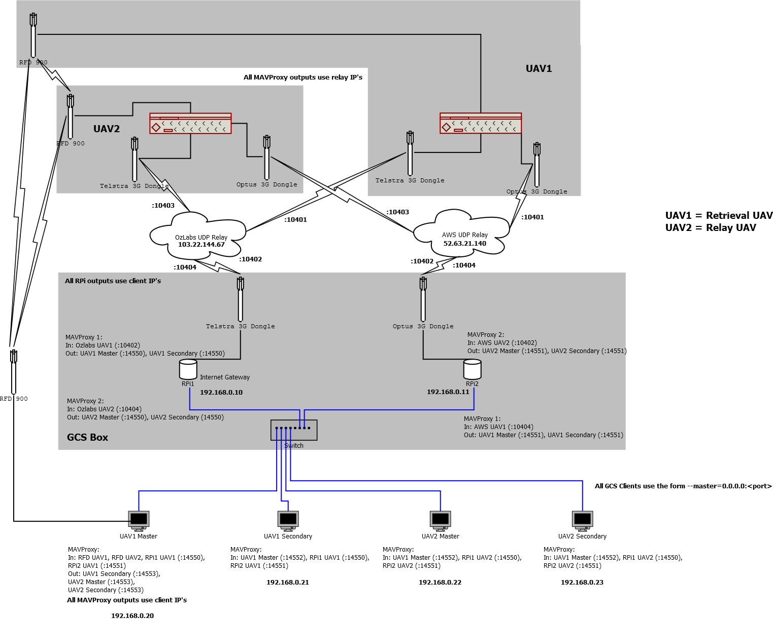
Comms - Redundancy

Slide 15
The End!
Link budgets
Typical types of communications systems
Redundancy

